Slide 1
Class 1: Paper overview and group organization
21st Century Power System Dynamics
EECS290O Spring 2019

Slide 2
Lin et al

Slide 3
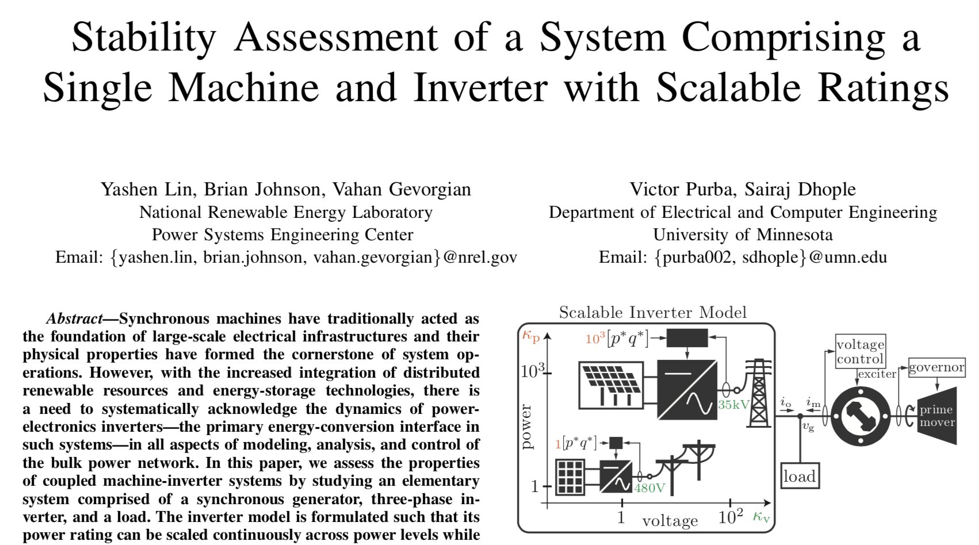

Slide 4
Summary
Model an elementary system comprised of a synchronous generator, three-phase inverter, and a load.
Inverter model: power rating can be scaled continuously across power levels while preserving its closed-loop response.
Assesses properties of the machine-inverter system for varying ratios of machine-to-inverter power ratings.
Small signal (linear) stability analysis
Surprising stability results. Most strongly depends on
Inverter current controller
Machine exciter

Slide 5
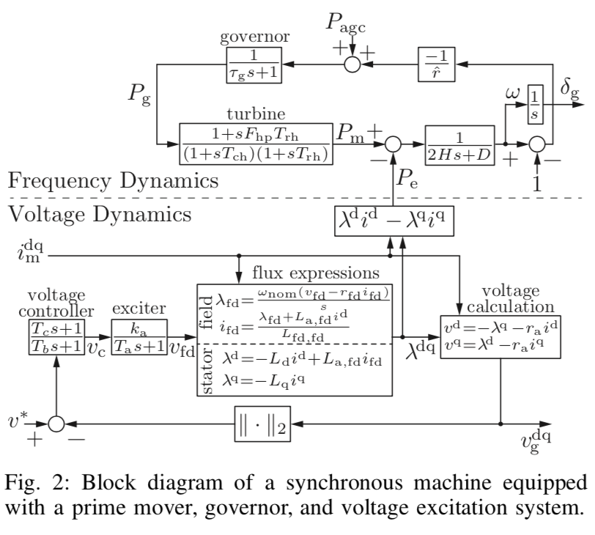
SM model
8 physical states
Neglects
stator- and damper-winding dynamics
power system stabilizer dynamics
nonlinearitites like magnetic-saturation effects, voltage limiters, and frequency limiters.

Slide 6
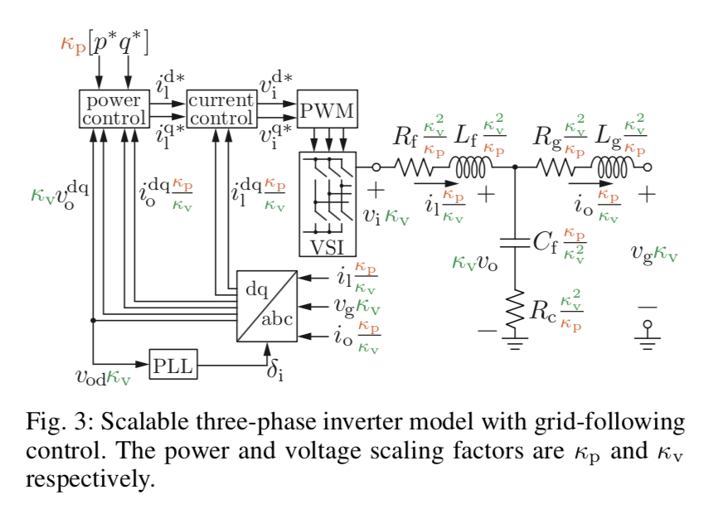
CIG model
15 internal states
Voltage source converter (controls current to maintain switch voltage)
”Grid feeding”

Slide 7
Other assumptions and comments
Balanced three phase
No transmission network
…
Other comments
Clear model description
…but need to consult other texts to uncover all of it

Slide 8
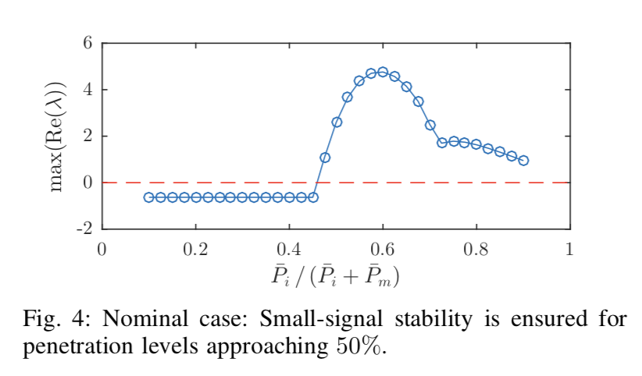
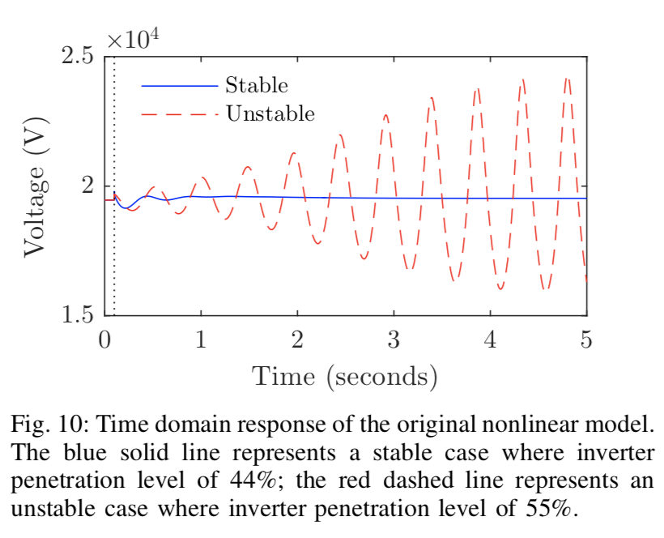
Interesting dynamics!

Slide 9
Curi et al

Slide 10
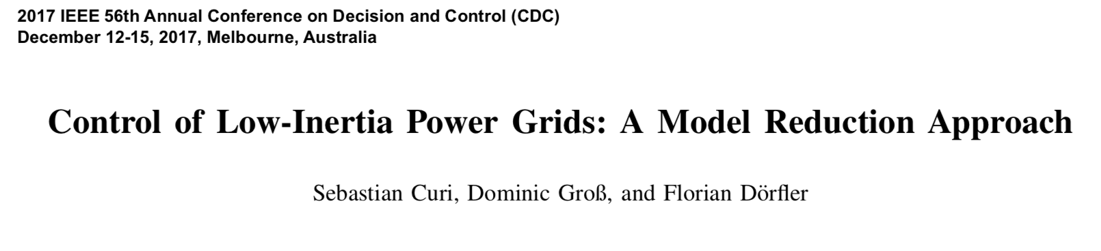
Develops a reduced-order model for analysis and control design of low-inertia power systems.
Uses singular perturbation theory to build a tractable model for control design.
Develops a nonlinear droop control that stabilizes the power system.

Slide 11
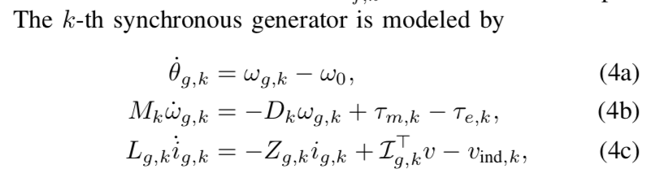
Comments on Curi et al
The most mathematical of the papers I propose
Beginning models very simple, e.g:
Includes a transmission model
Assumes balanced three phase system, among other things

Slide 12
Further comments on Curi et al
The CIG control strategy they propose is one of many currently under consideration
But it has an elegant connection to synchronous machine control
E.g., maps dc-side CIG voltage to SM frequency
Identifies a Lyapunov function for the system
This forms the basis for a nonlinear control law
Proves asymptotic stability, subject to a host of modeling assumptions

Slide 13
Markovic et al

Slide 14
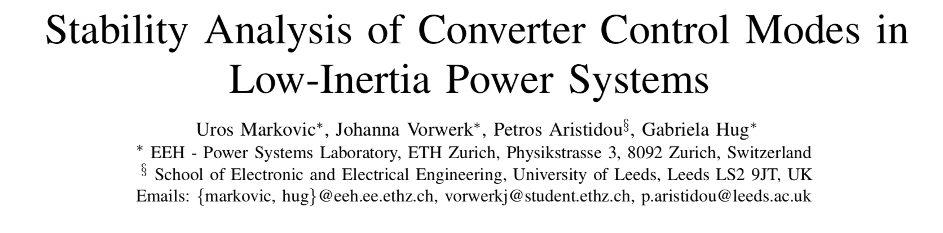

Slide 15
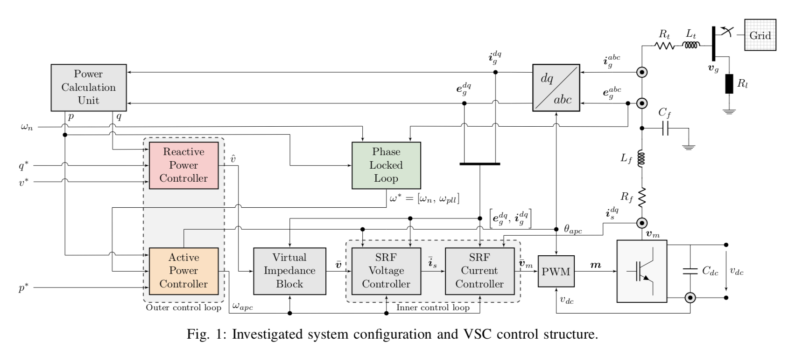
Markovic model
Relatively high detail on converter (15th order)
However ideal dc voltage source
Grid is “infinite bus” (no SM model)

Slide 16
Markovic, ctd
Performs small signal stability analysis for different CIG control strategies
”Grid feeding”
“Grid forming”
“Grid supporting”
Droop
“Virtual inertia”
Possibly the most detailed CIG model of the set we are considering
But no SM models – these would need to be added
Others at LBNL (and even in this class) have worked with this model

Slide 17
Ramasubramanian et al

Slide 18
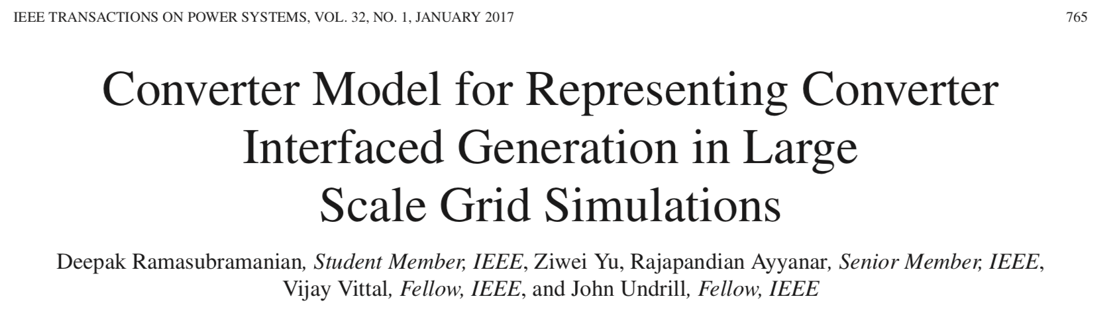
Integrates a simple converter-based sources in into commercial positive sequence transient stability analysis software.
Compares performance to “point on wave” simulation (time domain, unbalanced flow)

Slide 19
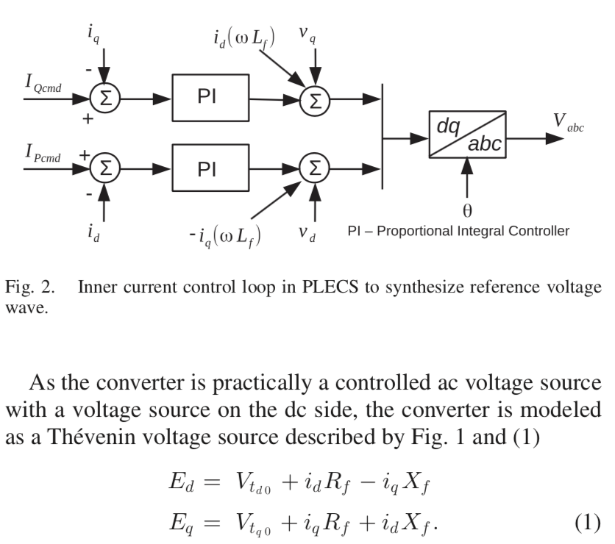
Ramasubramanian converter model is really simple:

Slide 20
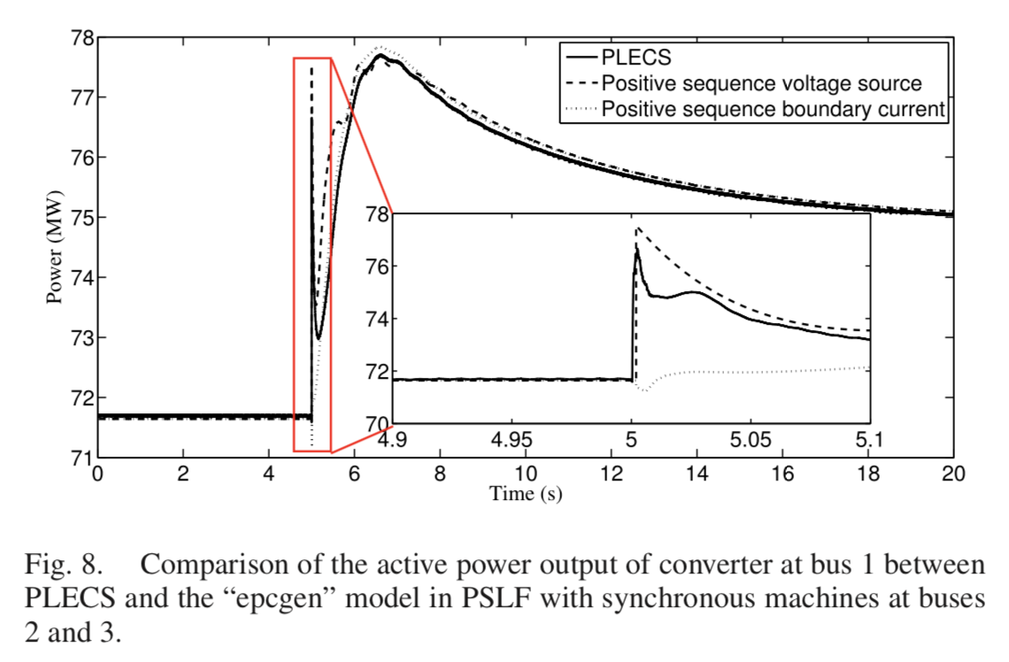
Ramasubramanian, ctd
Comparison between
PLECS (high order CIG modeling platform) and
simple model in PSLF (simpler positive sequence modeling platform)

Slide 21
Further thoughts on Ramasubramanian
Here, ideal dc voltage source
But this group has worked on other representations.
There is more room for rigor in developing reduced order converter model.

Slide 22
Breaking into initial groups
Lin et al
Curi et al
Markovic et al
Ramasubramanian et al
First,
Vote on paper you’re most interested in reading further
You can propose a different paper here if you wish.
Tell me if your background is primarily power systems, power electronics, or neither
Now we’ll solve this problem
Constraints:
Diverse background, if possible:
One power systems person
One power electronics person
3-4 people per group
Objective: Minimize number of people not on first choice paper

Slide 23
Now we are in G groups
For next week: Develop a 70/G minute presentation describing your paper
Paper objectives and stated contributions
Model overview
What is not clear
What seems easy to implement
Focus on SM and CIG model description
Key assumptions
Key results and significance
What you think you’d like to further explore; Focus is on the models
Make presentation intelligible to folks with background in neither power system dynamics and control nor power electronics
There will be a chance to regroup if desired.

Slide 24
After next week
We will first work through chapters in two text books:
Dynamics: Machowski et al, Power System Dynamics: Stability and Control, 2nd Edition (2008)
Converters: Yazdani and Iravani, Voltage Sourced Converters in Power Systems (2010).
Both are available online via Berkeley library.
We will discuss a detailed plan of attack next week.

